Slide 1




DIGITAL WORK PASSPORT
A Digital Work History and Job-Matching Platform for Informal Workers
t
FOUNDATIONS OF ARTIFICIAL INTELLIGENCE
Presented By
HARINI NAGARAJAN 240701167
HARISHNI.B 240701176

Slide 2


Millions of informal workers in India work as domestic helpers, beauticians, tailors, cooks, vendors, construction workers, and other independent service providers. However, much of their work experience and income remains undocumented.
As a result, workers may struggle to prove their experience when applying for better jobs, demonstrate their income when seeking financial services, identify relevant government welfare schemes, and maintain records of their employment and client relationships.
Communication barriers between workers and clients who speak different languages can further limit employment opportunities.
Therefore, there is a need for a simple digital platform that creates a verified work history, supports worker–client communication, enables multilingual access, and helps workers discover better employment opportunities.
Problem Statement

Slide 3


The Digital Work Passport is a web-based platform designed to help informal workers maintain a digital record of their work experience, income history, client confirmations, and ratings.
The platform allows workers and clients to communicate through an integrated messaging system. Messages can be translated into the user's preferred language, and the website interface is available in Tamil, English, and Hindi.
The system uses React.js for the frontend, FastAPI for the backend, and SQLite for data storage. Artificial Intelligence search and constraint-solving techniques are incorporated through the A* search algorithm and Constraint Satisfaction Problem (CSP) approach to support job matching and rule-based eligibility checks.
The proposed system aims to improve the visibility of informal work, simplify communication, and support access to employment opportunities and relevant welfare information.
Abstract

Slide 4


Literature Survey
  Digital Work Records: Digital profiles and employment records can help workers present their skills and previous experience.
  Online Job-Matching Platforms: Existing platforms connect service providers with customers using skills, location, availability and other preferences.
  Rating and Review Systems: Customer feedback and job confirmations can help build a record of reliability and service quality.
  Multilingual Digital Platforms: Regional-language interfaces and message translation can reduce communication barriers between people who speak different languages.
  AI-Based Search and Constraint Solving: Search algorithms and constraint-based techniques can support the selection of suitable jobs and checking of predefined requirements.
Identified opportunity: Integrate digital work-history records, client confirmations, worker–client messaging, multilingual access and AI-based job matching into one platform for informal workers.

Slide 5


Existing VS Proposed
Existing
Proposed
  Work experience is often recorded informally or scattered across different sources.
  Workers may find it difficult to provide proof of previous jobs.
  Income records may be unavailable or incomplete.
  Communication between workers and clients can be affected by language differences.
  Finding suitable and better-paying jobs can be challenging.
  Information about welfare schemes and eligibility requirements may be difficult to access.
  Client feedback and job confirmations may not be maintained in a single record.
  Create a digital profile and work-history record for each worker.
  Maintain job details, client confirmations and ratings.
  Enable direct messaging between workers and clients.
  Translate messages into the selected target language.
  Provide the website interface in Tamil, English and Hindi.
  Use A* search to help identify suitable job opportunities.
  Apply CSP constraints to check job requirements and predefined eligibility conditions.
  Present relevant welfare-scheme information and job opportunities through one platform.

Slide 6





Research Gap
1. Existing Situation
2. Identified Opportunity
3. Problem Formulation
Informal workers may lack a consolidated digital record of their employment history, experience and client feedback.
A unified platform can connect work-history documentation, client communication, multilingual messaging and job discovery.
The system must organize worker and job information and identify suitable matches while satisfying requirements such as skills, location, availability and job conditions.
4. Language Accessibility
5. Proposed AI Approach
Workers and clients may prefer different languages. Message translation and a multilingual interface can make communication more accessible.
Algorithm: A* finds suitable job matches, while CSP checks job constraints.
Research Gap: An accessible platform combining digital work records, multilingual communication, and AI-based job matching for informal workers.

Slide 7


Research Objectives
  Develop a digital platform for informal workers to create profiles and maintain work-history records.
  Record completed jobs, client confirmations, ratings and available income details.
  Enable messaging between workers and clients.
  Translate messages between supported languages to reduce communication barriers.
  Provide the website interface in Tamil, English and Hindi.
  Apply the A* search algorithm to identify and prioritize suitable job opportunities.
  Use CSP-based constraint checking for job requirements and predefined eligibility rules.
  Help workers discover relevant employment opportunities and information about government welfare schemes.
  Maintain structured records using an SQLite database.
  Design a simple, accessible web application using React.js and FastAPI.

Slide 8
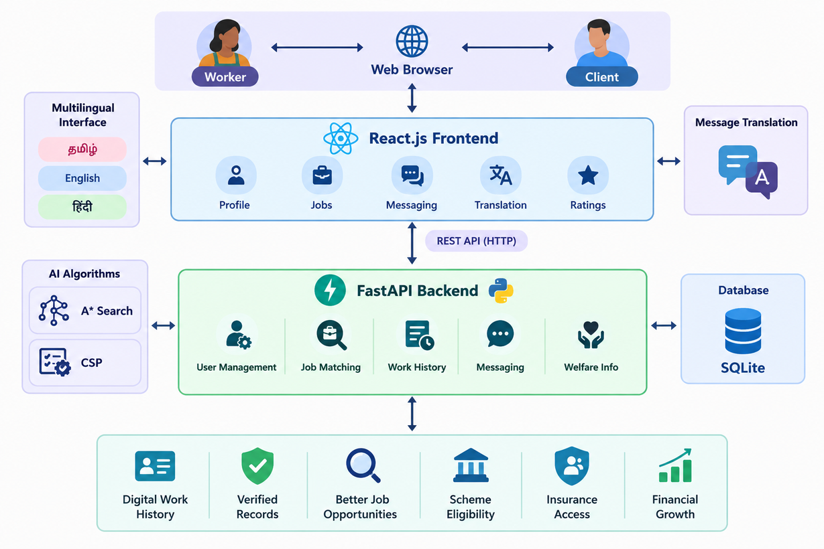
Architecture Diagram

Slide 9


Algorithms
A* Search Algorithm
Problem: Finding and prioritizing suitable job opportunities for a worker.
A* is a search algorithm that evaluates possible paths or states using the function:
f(n) = g(n) + h(n)
g(n): Cost accumulated so far.
h(n): Estimated remaining cost to reach the goal.
f(n): Combined cost used to prioritize which state to explore.
CSP Algorithm
It helps identify valid assignments and reject combinations that violate specified rules. Scheme-related results should be presented as preliminary checks; official eligibility and approval depend on the relevant authorities.
Combined Approach
A* prioritizes promising job matches, while CSP checks whether the selected matches satisfy the required constraints.

Slide 10


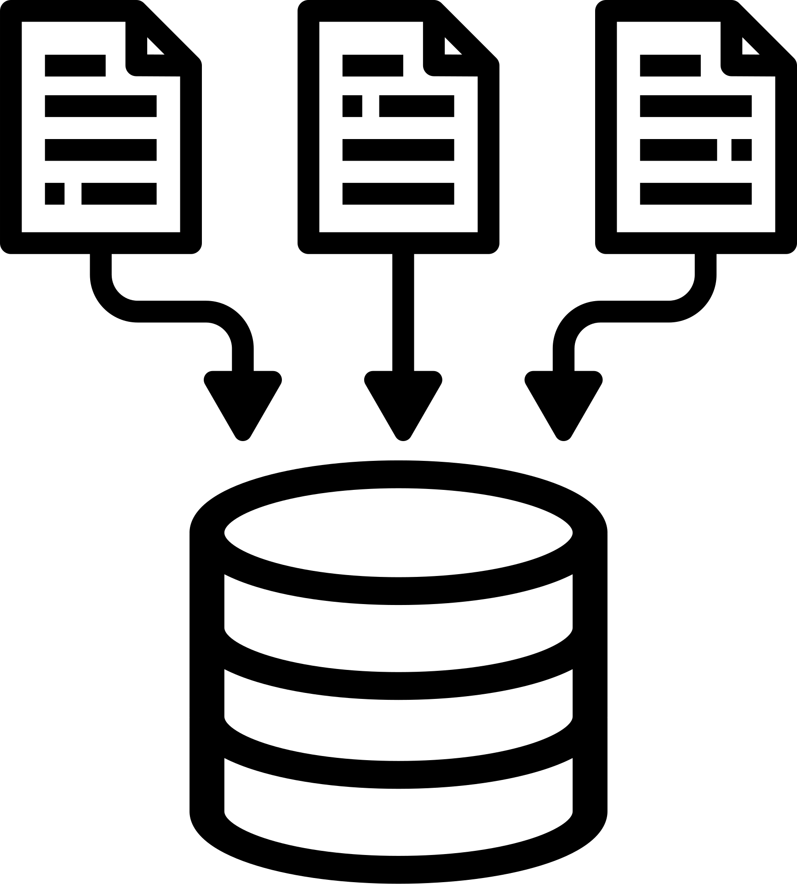
Implementation
Frontend
  React.js (JavaScript/JSX)
  CSS
Backend
  Python
  FastAPI
  REST API endpoints
Database
  SQLite

Slide 11

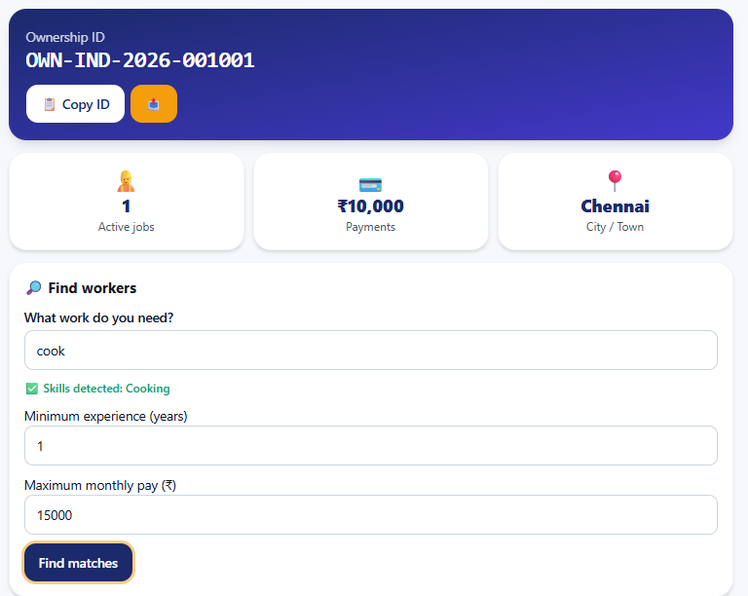
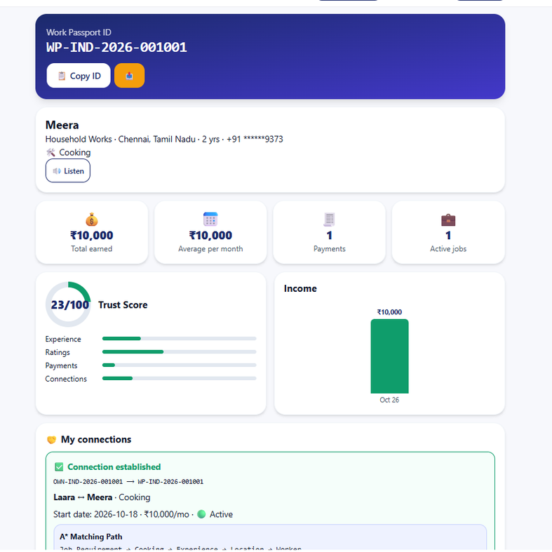
Output
Owner’s Dashboard
Worker’s Dashboard

Slide 12


